Slide 1
On your mark,
get set,
write!

Slide 2
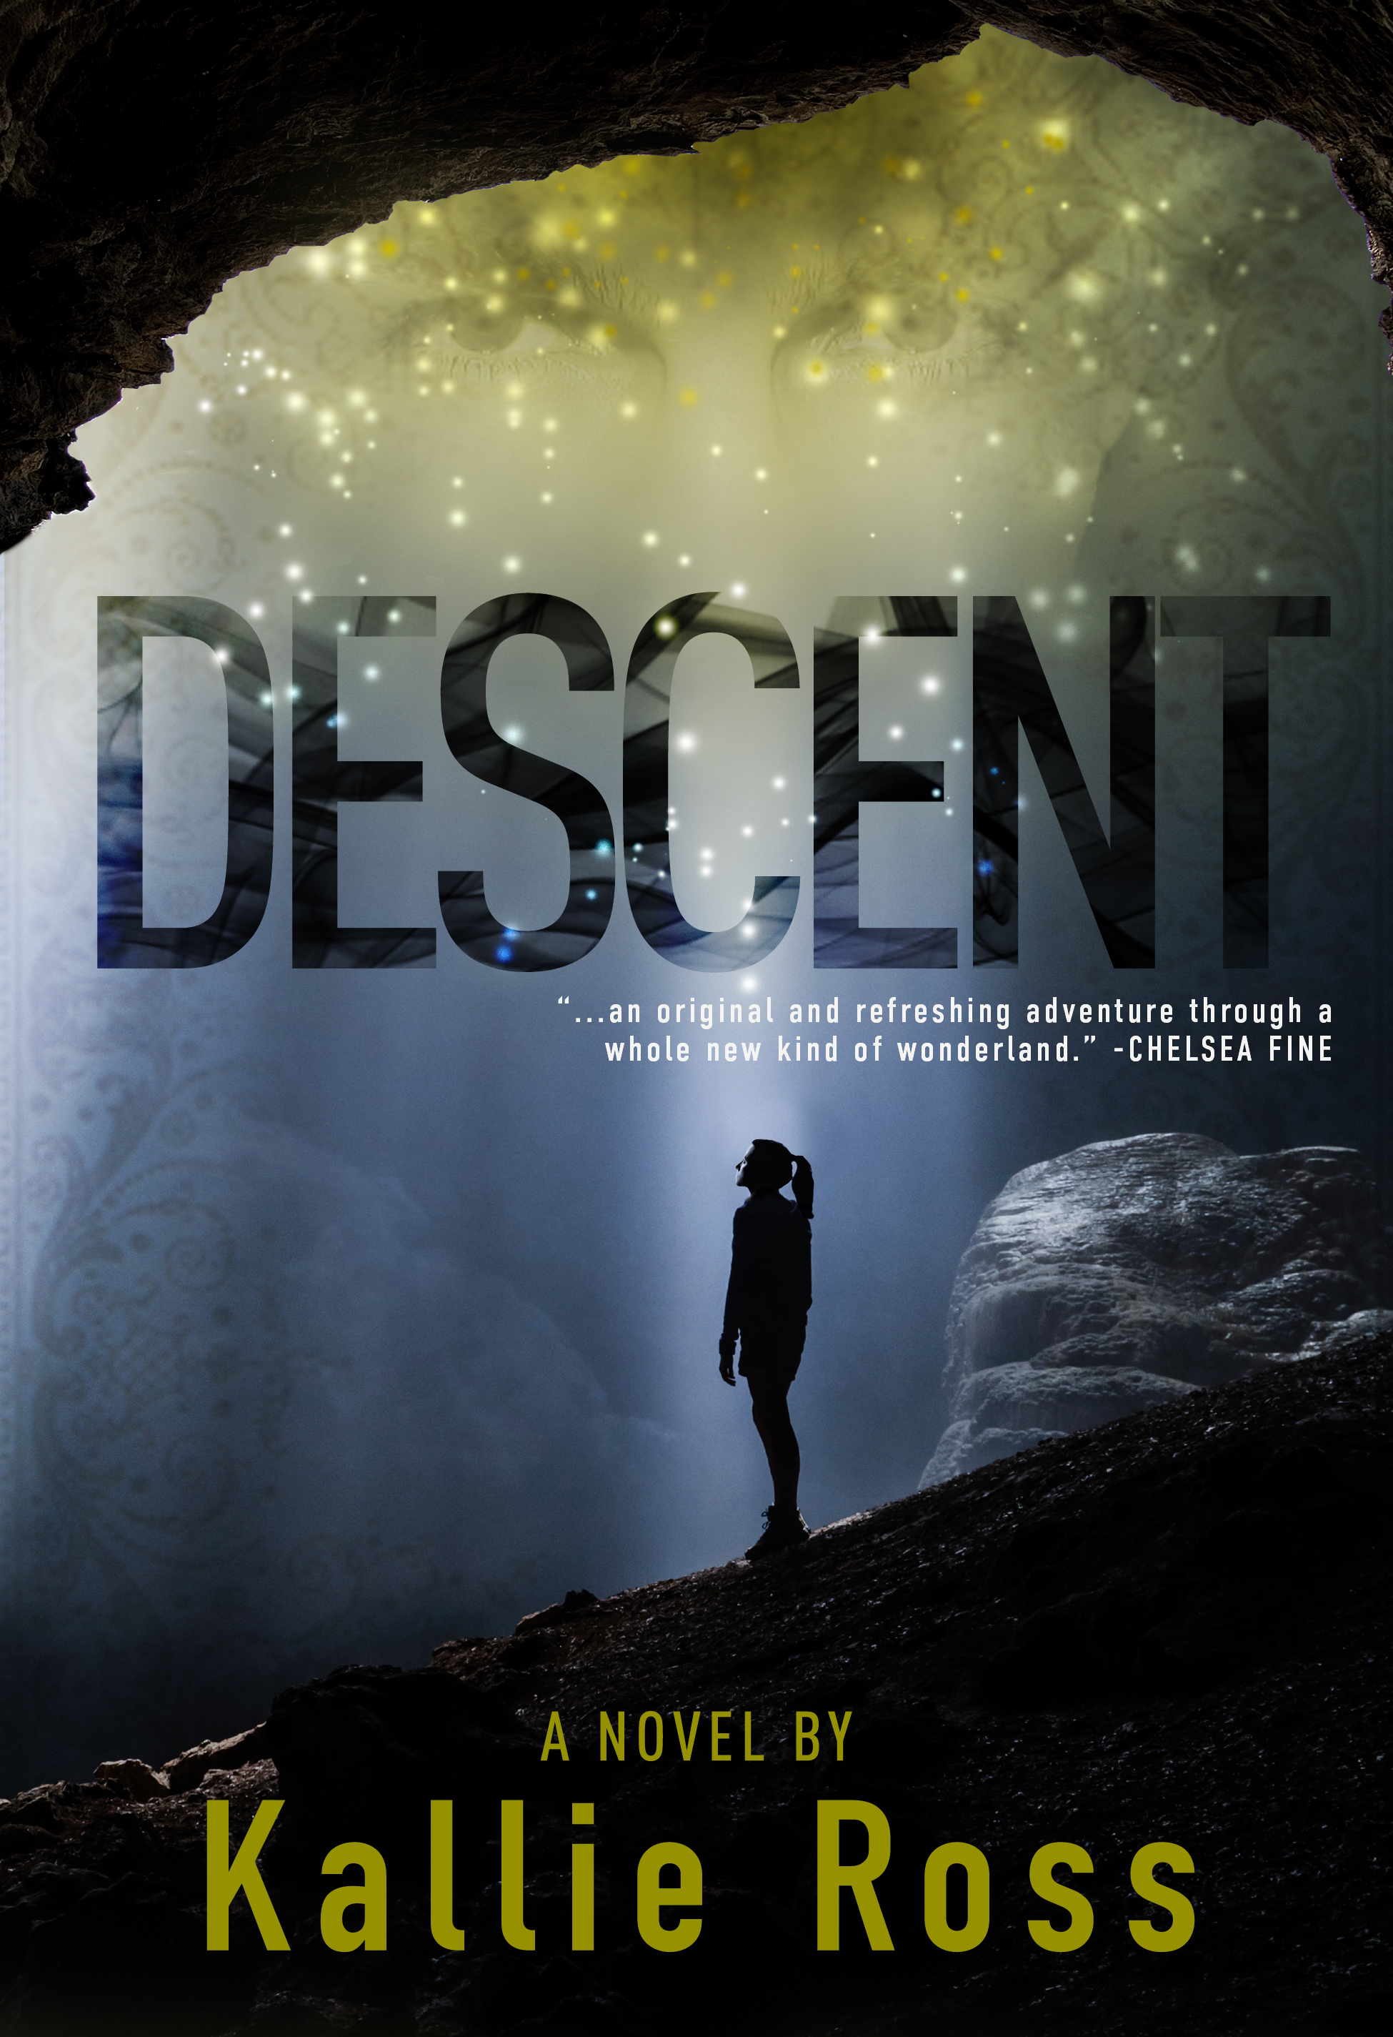

Slide 3
What Writing really
looks like
1. Open a new Word document.
2. Save it as tentative book title.
3. Wonder if any other books have this title
4. Check Twitter.
5. Google tentative book title.
6. Feel relieved that you’re somewhat original.
7. Type the title and “Chapter One” in Word document.
8. Check e-mail.
9. Check Facebook.
10. Stare at blinking cursor in Word document.
11. Check latest favorite blogs & tumblrs.
12. Type first sentence.
13. Click “save.”
14. Feel accomplished.
15. Feel thirsty.
16. Refill water glass.
17. Check Twitter.
18. Click on five different-yet-equally-inane HuffPo links.
19. Stare at blinking cursor after first sentence.
20. Realize that, though this is the third novel you’ve written, you’ve completely forgotten the principles on how to successfully start a novel.
21. Write blog post about it.
22. Type second sentence?
http://www.writersdigest.com/editor-blogs/guide-to-literary-agents/how-to-start-a-new-novel-in-22-easy-steps

Slide 4
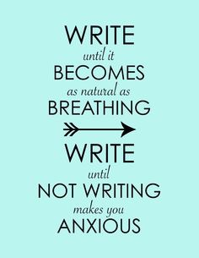
Write, Eat, Sleep, Repeat.
How often are you writing?
List your excuses.
Prioritize.
Make a specific schedule.
Stick to it.

Slide 5
What will you write?
Whether it’s self-help, historical, science or children’s fiction you should work through your idea before starting. It may be what carries you over the finish line in ‘The End’.

Slide 6
Novel Idea(s)
List your ideas.
Narrow the list to 3-4 favorite.
Write a short summary for each.
Choose the idea that inspires you most.
Notes:
Once you have the idea that inspires you, make sure the story has…
1 A Protagonist with a Goal—an intriguing, compelling goal driven by a core need.
2 A Conflict with High Stakes: Not just small personal stakes but ones that affect those around her or him, or the world at large.
3 A Concept with a “Kicker”: There needs to be something truly unique or riveting about your concept to take it out of the realm of ordinary and boring.
4 A Theme with Heart: Every story has some kind of theme. The best novels have the best themes. Why are you excited about this idea? What message do you see this book conveying, and why is it relevant, universal, and important?

Slide 7
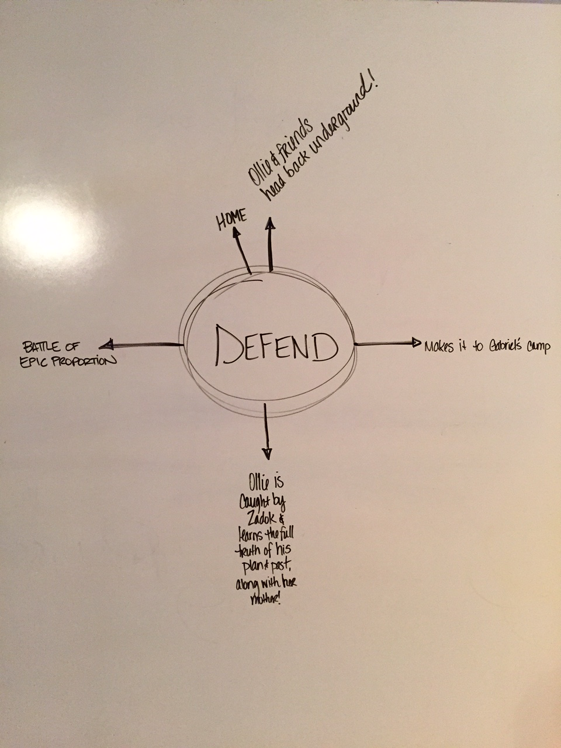
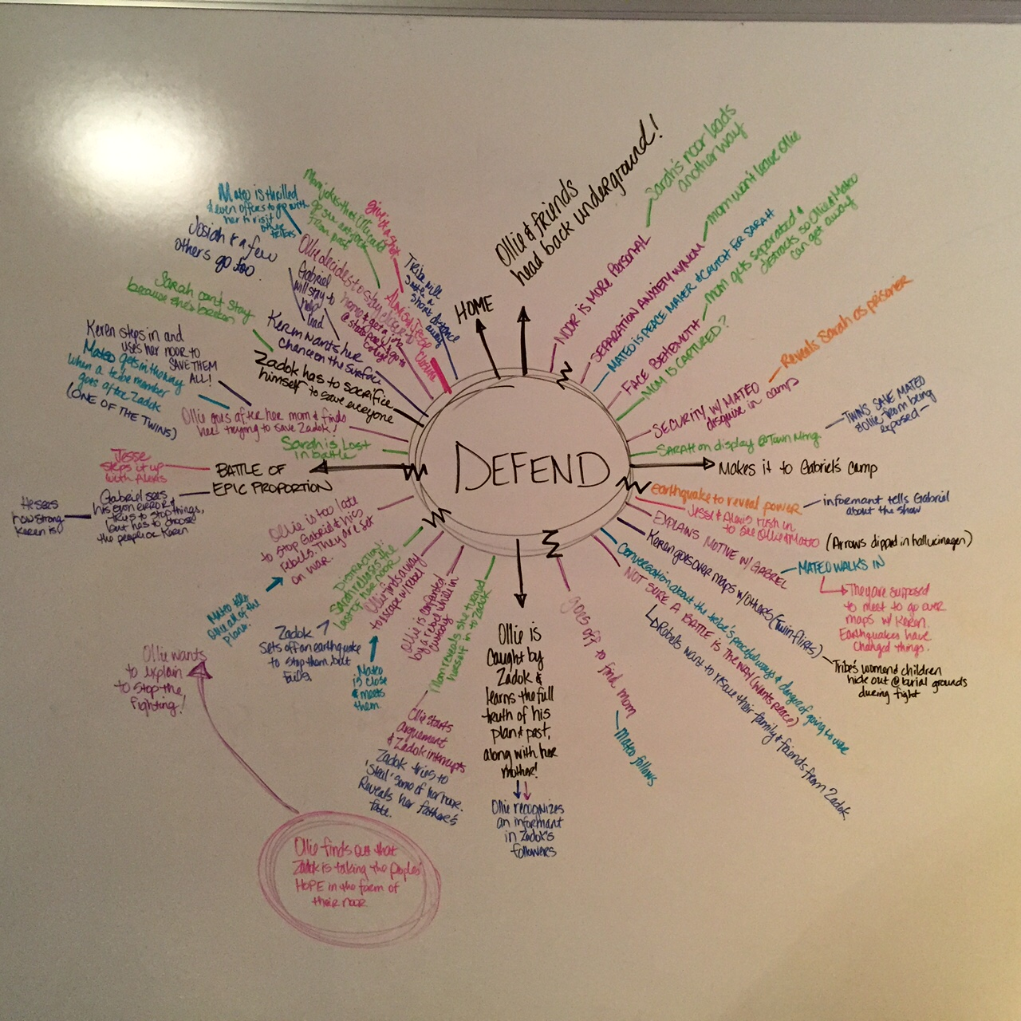
Outlining
Lengthy Summary
Chapter-By-Chapter
Backwards
Spiderweb
Circular

Slide 8
5 Great Tips For Chapter One
Create a story for your character.
Include minimal backstory.
Add character-defining sensory details.
Make secondary characters significant.
Instead of ‘write what you know’ write what you feel.
Notes:
Create a story for your character.
• Have you given us a character with following?
• Have you created a disturbance for that character in the opening pages?
• Have you established the stakes (the higher the better) for the story?
• Have you created a scene that will force the character into the conflict/confrontation central to the plot?
• Is that scene strong enough—to the point that your character cannot resist walking through that doorway (or has no choice but to do so)?
Include minimal backstory.
Add character-defining sensory details.
No: She was wearing Chanel No. 5.
Yes: She was wearing Chanel No. 5 like in the old days, he noticed—that sophisticated, mind-coat-and-diamonds fragrance that always quickened his pulse.
Make secondary characters significant.
Instead of ‘write what you know’ write what you feel.

Slide 9
Phases of Writing
Rough Draft
Revisions/Alpha Readers
Take a step away!
Edits/Beta Readers
Take another step away!
Final Proofread

Slide 10
Resources
WritersDigest.com
WriteToDone.com
TerribleMinds.com
Indie Pub Podcast
Scrivener
Google Drive

Slide 11
Question & Answer

